Slide 1
Maths and Statistical Foundations for Analytics
Lecture 5: Sampling Distribution

Slide 2
6.1 Sampling Error; the Need for Sampling Distributions

Slide 3
Definition 6.1
Sampling Error
Sampling error is the error resulting from using a sample to estimate a population characteristic.

Slide 4
Definition 6.2
Sampling Distribution of the Sample Mean
For a variable x and a given sample size, the distribution of
the variable
is called the sampling distribution of the
sample mean.

Slide 5
Example
Heights, in inches, of the five starting players
Player A B C D E
Height 76 78 79 81 86
a) Obtain the sampling distribution of the sample mean for samples of size 2.
b) Make some observations about sampling error when the mean height of a random sample of two players is used to estimate the population mean height.
c) Find the probability that, for a random sample of size 2, the sampling error made in estimating the population mean by the sample mean will be 1 inch or less; that is, determine the probability that . x will be within 1 inch of μ.

Slide 6
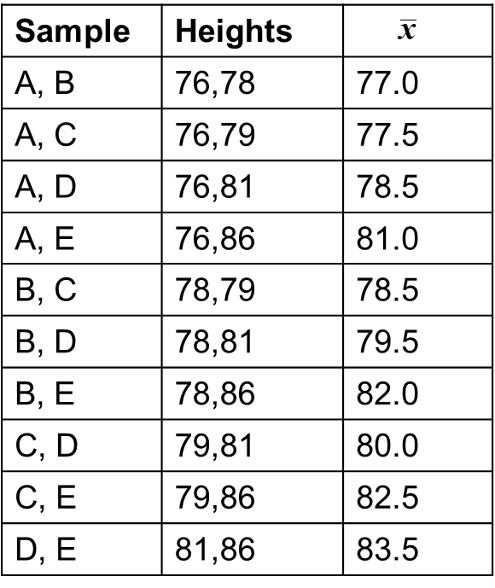
Table 6-2
Possible samples and sample means for samples of size 2

Slide 7
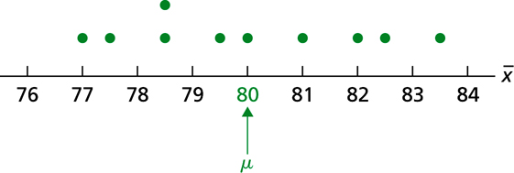
Figure 6-1
Dotplot for the sampling distribution of the sample mean for samples of size 2 ( n = 2)

Slide 8
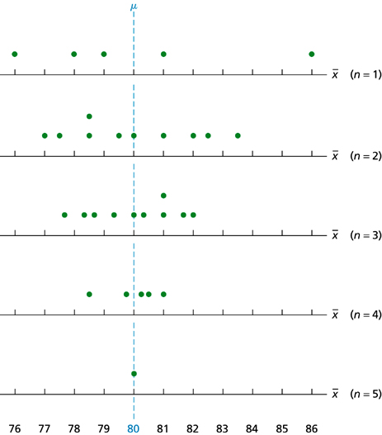
Figure 6-3
Dotplots for the sampling distributions of the sample mean for the heights of the five starting players for samples of sizes 1, 2, 3, 4, and 5

Slide 9
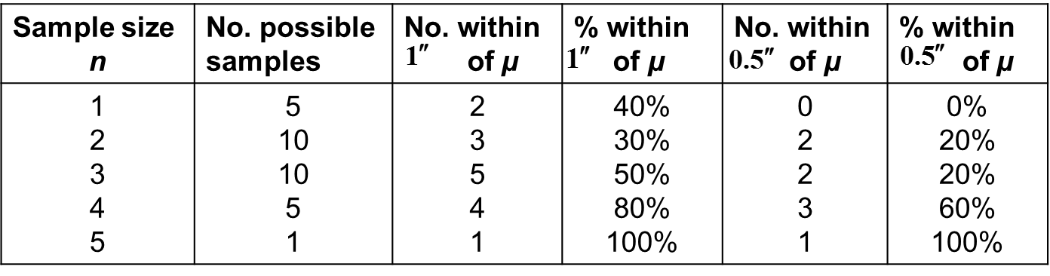
Table 6-4
Sample size and sampling error illustrations for the heights of the basketball players (“No.” is an abbreviation of “Number”)

Slide 10
Key Fact 6.1
Sample Size and Sampling Error
The larger the sample size, the smaller the sampling error tends to be in estimating a population mean, μ, by a sample
mean,

Slide 11
6.2 The Mean and Standard Deviation of the Sample Mean

Slide 12
Formula 6.1
Mean of the Sample Mean
For samples of size n, the mean of the variable
equals the mean of the variable under consideration. In symbols,

Slide 13
Formula 6.2
Standard Deviation of the Sample Mean
For samples of size n, the standard deviation of the variable
equals the standard deviation of the variable under consideration divided by the square root of the sample size. In symbols,

Slide 14
6.3 The Sampling Distribution of the Sample Mean

Slide 15
Key Fact 6.2
Sampling Distribution of the Sample Mean
for a Normally Distributed Variable
Suppose that a variable x of a population is normally distributed with mean μ and standard deviation σ. Then, for
samples of size n, the variable
is also normally
distributed and has mean μ and standard deviation

Slide 16
Key Fact 6.3
The Central Limit Theorem (C L T)
For a relatively large sample size, the variable
is approximately normally distributed, regardless of the distribution of the variable under consideration. The approximation becomes better with increasing sample size.

Slide 17
Key Fact 6.4
Sampling Distribution of the Sample Mean
Suppose that a variable x of a population has mean μ and standard deviation σ. Then, for samples of size n,
the mean of
equals the population mean, or
the standard deviation of
equals the population standard deviation
divided by the square root of the sample size, or
if x is normally distributed, so is
regardless of sample size; and
if the sample size is large,
is approximately normally distributed,
regardless of the distribution of x.

